Slide 1


CMR TECHNICAL CAMPUS
UGC(Autonomous)
Kandlakoya,Medchal Road,Hyd-501 401 Department of Computer Science Engineering
Major Project On
CREDIT CARD FRAUD DETECTION USING STATE OF THE ART USING MACHINE LEARNING AND DEEP LEARNING ALGORITHM
BATCH NO : 22
Project Guide: BATCH MEMBERS:
Ms. Saba Sultana 207R1A0595 M RISHITHA REDDY
Assistant Professor, CSE Department 207R1A0580 GUGLAVATH SRISHANTH
217R5A0508 MARIPEDDA PRAVEEN
Project Coordinator:
J.Narasimharao
Associate Professor, CSE Department

Slide 2
CCONTENTS:
INTRODUCTION AND THE OVERVIEW OF THE PROJECT (ABSTRACT)
EXISTING SYSTEM
DISADVANTAGES OF EXISTING SYSTEM
PROPOSED SYSTEM
ADVANTAGES OF PROPOSED SYSTEM
SYSTEM REQUIREMENTS
NOVELTY OF PROJECT
ARCHITECTURE
UML DIAGRAMS
CONCLUSION.

Slide 3
ABSTRACT
Credit cards have become an integral part of modern financial transactions, providing users with a convenient and widely accepted method of payment. The widespread use of credit cards, both online and offline, has, however, given rise to the escalating threat of credit card fraud.
Fraudulent activities such as unauthorized transactions, identity theft, and skimming pose substantial risks to financial institutions and cardholders. With the increasing prevalence of online transactions, the risk of credit card fraud has become a major concern for financial institutions and users alike.
This study proposes an advanced Credit Card Fraud Detection system leveraging state-of-the-art machine learning and deep learning algorithms to enhance the accuracy and efficiency of fraud detection.

Slide 4
EXISTING SYSTEM
The current system for detecting credit card fraud uses a mix of rules, statistics, and machine learning. It looks at transaction data, finds patterns that suggest fraud, and uses algorithms to separate real transactions from fraudulent ones.
These algorithms learn from past data to recognize new fraud attempts. The system is regularly checked to make sure it's working well.
ML has many branches, and each branch can deal with different learning tasks. However, ML learning has different framework types. The ML approach provides a solution for CCF, such as random forest (RF).
The ensemble of the decision tree is the random forest. Most researchers use the RF approach. To combine the model, we can use (RF) along with network analysis.

Slide 5
DISADVANTAGES OF EXISTING SYSTEM
The system is not implemented Classification on Imbalanced Data.
The system is not implemented CONVOLUTIONAL NEURAL NETWORK (CNN) for test and train the datasets.

Slide 6
PROPOSED SYSTEM
The proposed system for credit card fraud detection aims to enhance accuracy and efficiency by integrating state-of-the-art machine learning and deep learning algorithms.
It will leverage advanced techniques such as deep neural networks and anomaly detection methods to better identify fraudulent transactions.
Additionally, the system will focus on continuous learning and adaptation to evolving fraud patterns, ensuring robust protection against fraudulent activities.
In this project, Feature selection algorithms are used to rank the top features from the CCF transaction dataset, which help in class label predictions.

Slide 7
ADVANTAGES OF PROPOSED SYSTEM
The proposed system uses SUPERVISED MACHINE LEARNING APPROACHES which are effective for testing and training datasets.
The proposed system implemented CNN is to minimize processing without losing key features by reducing the image to make predictions.

Slide 8
SYSTEM REQUIRMENTS
HARDWARE REQUIRMENTS
• System Processor : Intel core i3 or above
Hard Disk : Minimum of 8GB and above
Ram : Minimum of 8GB and above

Slide 9
SOFTWARE REQUIRMENTS
Operating Systems : Window 8 or above
Coding Languages : Python
Front-End : Python.
Back-End : Django-ORM
Designing : HTML, CSS, Javascript
Data Base : MySQL (WAMP Server).

Slide 10
NOVELTY OF PROJECT
The novelty of this project lies in its integration of cutting-edge machine learning and deep learning techniques to improve credit card fraud detection.
By leveraging state-of-the-art algorithms, the system aims to achieve higher accuracy and efficiency compared to traditional methods.
Additionally, the focus on continuous learning and adaptation to evolving fraud patterns ensures that the system remains effective in detecting new and sophisticated fraud attempts.
Overall, the project represents an innovative approach to addressing the challenge of credit card fraud detection in today's rapidly evolving financial landscape.

Slide 11
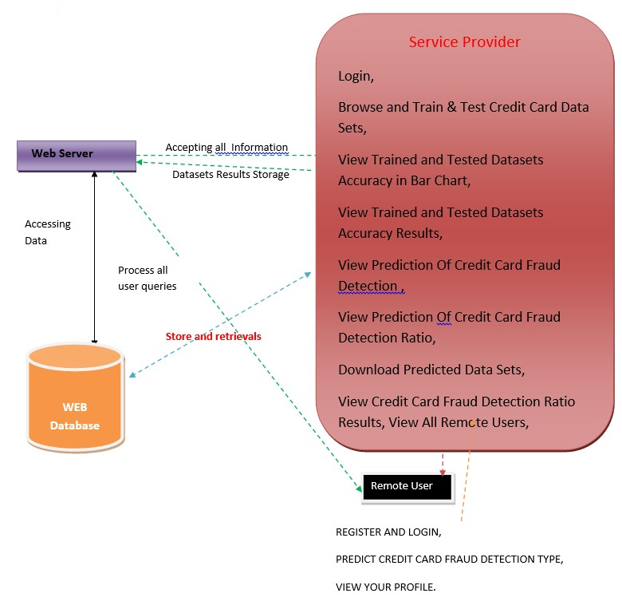
ARCHITECTURE

Slide 12
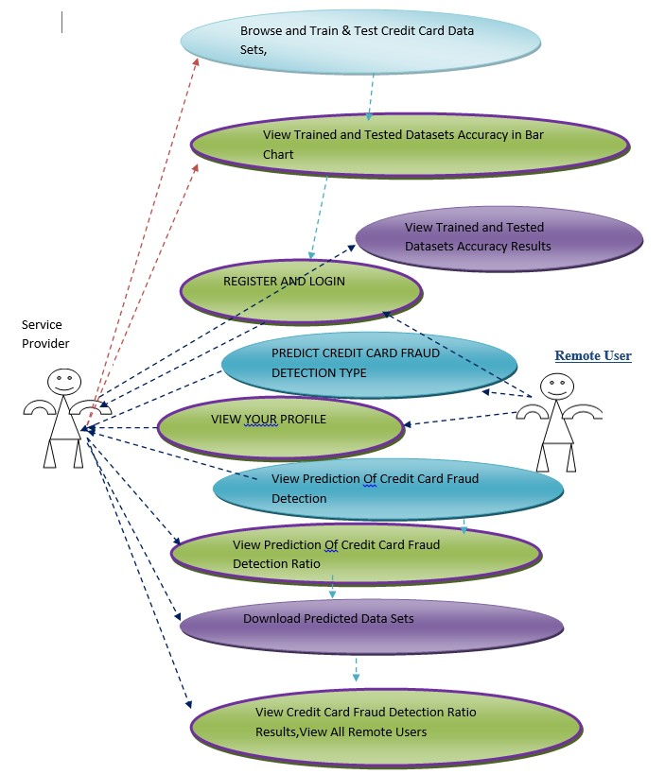










UML DIAGRAMS
USE CASE DIAGRAM

Slide 13
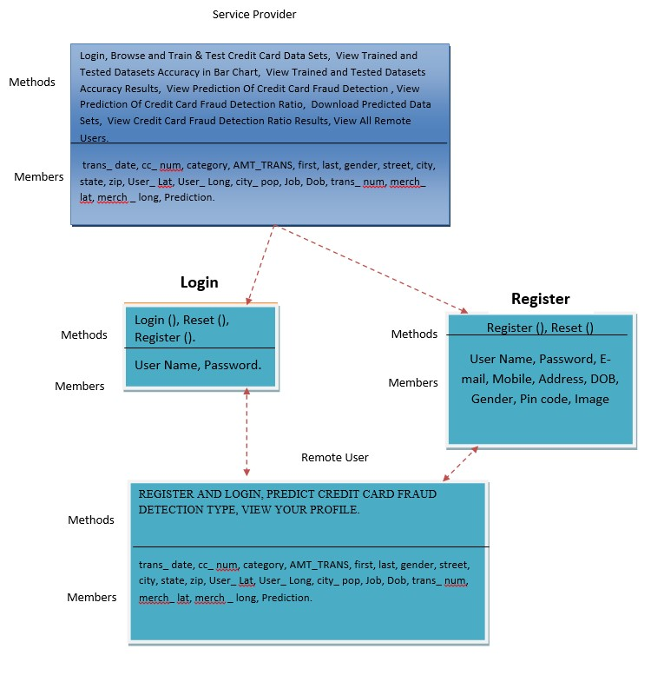
CLASS DIAGRAM

Slide 14
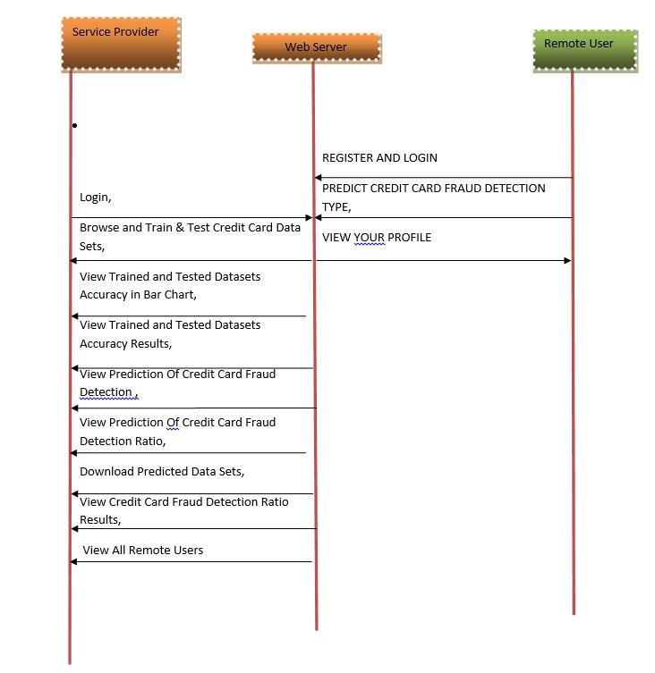
SEQUENCE DIAGRAM

Slide 15
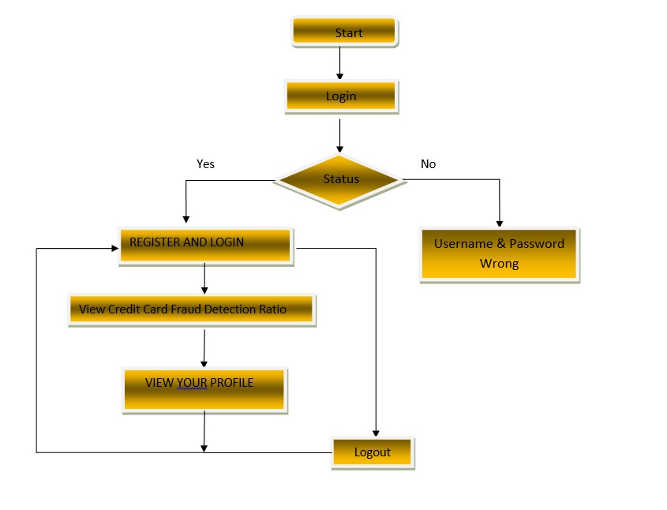
ACTIVITY DIAGRAM

Slide 16
SAMPLE CODE
rom django.db.models import Count, Avg
from django.shortcuts import render, redirect
from django.db.models import Count
from django.db.models import Q
import datetime
import xlwt
from django.http import HttpResponse
import pandas as pd
from sklearn.feature_extraction.text import CountVectorizer
from sklearn.metrics import accuracy_score, confusion_matrix, classification_report
from sklearn.metrics import accuracy_score
from sklearn.tree import DecisionTreeClassifier
# Create your views here.
from Remote_User.models import ClientRegister_Model,cc_fraud_detection_type,detection_ratio,detection_accuracy

Slide 17
def serviceproviderlogin(request):
if request.method == "POST":
admin = request.POST.get('username')
password = request.POST.get('password')
if admin == "Admin" and password =="Admin":
detection_accuracy.objects.all().delete()
return redirect('View_Remote_Users')
return render(request,'SProvider/serviceproviderlogin.html')
def View_CC_Fraud_Detection_Ratio(request):
detection_ratio.objects.all().delete()
ratio = ""
kword = 'No Credit Card Fraud'
print(kword)
obj = cc_fraud_detection_type.objects.all().filter(Q(Prediction=kword))
obj1 = cc_fraud_detection_type.objects.all()
count = obj.count();
count1 = obj1.count();
ratio = (count / count1) * 100
if ratio != 0:
detection_ratio.objects.create(names=kword, ratio=ratio)

Slide 18
ratio = ""
kword = 'No Credit Card Fraud'
print(kword)
obj = cc_fraud_detection_type.objects.all().filter(Q(Prediction=kword))
obj1 = cc_fraud_detection_type.objects.all()
count = obj.count();
count1 = obj1.count();
ratio = (count / count1) * 100
if ratio != 0:
detection_ratio.objects.create(names=kword, ratio=ratio)
ratio12 = ""
kword12 = 'Credit Card Fraud'
print(kword12)
obj12 = cc_fraud_detection_type.objects.all().filter(Q(Prediction=kword12))
obj112 = cc_fraud_detection_type.objects.all()
count12 = obj12.count();
count112 = obj112.count();
ratio12 = (count12 / count112) * 100
if ratio12 != 0:

Slide 19
def View_Remote_Users(request):
obj=ClientRegister_Model.objects.all()
return render(request,'SProvider/View_Remote_Users.html',{'objects':obj})
def charts(request,chart_type):
chart1 = detection_ratio.objects.values('names').annotate(dcount=Avg('ratio'))
return render(request,"SProvider/charts.html", {'form':chart1, 'chart_type':chart_type})
def charts1(request,chart_type):
chart1 = detection_accuracy.objects.values('names').annotate(dcount=Avg('ratio'))
return render(request,"SProvider/charts1.html", {'form':chart1, 'chart_type':chart_type})
def View_Prediction_Of_CC_Fraud_Detection(request):
obj =cc_fraud_detection_type.objects.all()
return render(request, 'SProvider/View_Prediction_Of_CC_Fraud_Detection.html', {'list_objects': obj})
def likeschart(request,like_chart):
charts =detection_accuracy.objects.values('names').annotate(dcount=Avg('ratio'))
return render(request,"SProvider/likeschart.html", {'form':charts, 'like_chart':like_chart})
def Download_Predicted_DataSets(request):

Slide 20
from sklearn.ensemble import GradientBoostingClassifier
clf = GradientBoostingClassifier(n_estimators=100, learning_rate=1.0, max_depth=1, random_state=0).fit(
X_train,
y_train)
clfpredict = clf.predict(X_test)
print("ACCURACY")
print(accuracy_score(y_test, clfpredict) * 100)
print("CLASSIFICATION REPORT")
print(classification_report(y_test, clfpredict))
print("CONFUSION MATRIX")
print(confusion_matrix(y_test, clfpredict))
models.append(('GradientBoostingClassifier', clf))
detection_accuracy.objects.create(names="Gradient Boosting Classifier",
ratio=accuracy_score(y_test, clfpredict) * 100)
csv_format = 'Results.csv'
df.to_csv(csv_format, index=False)
df.to_markdown
obj = detection_accuracy.objects.all()
return render(request,'SProvider/train_model.html', {'objs': obj})

Slide 21
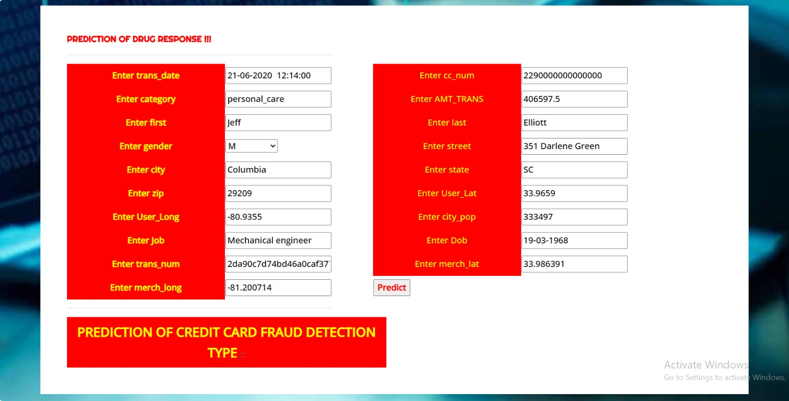

Slide 22
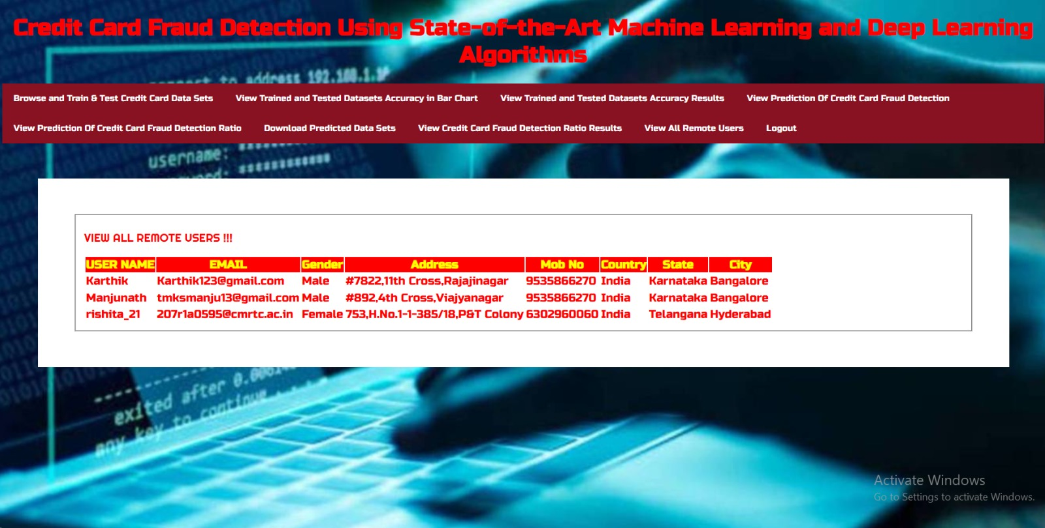

Slide 23
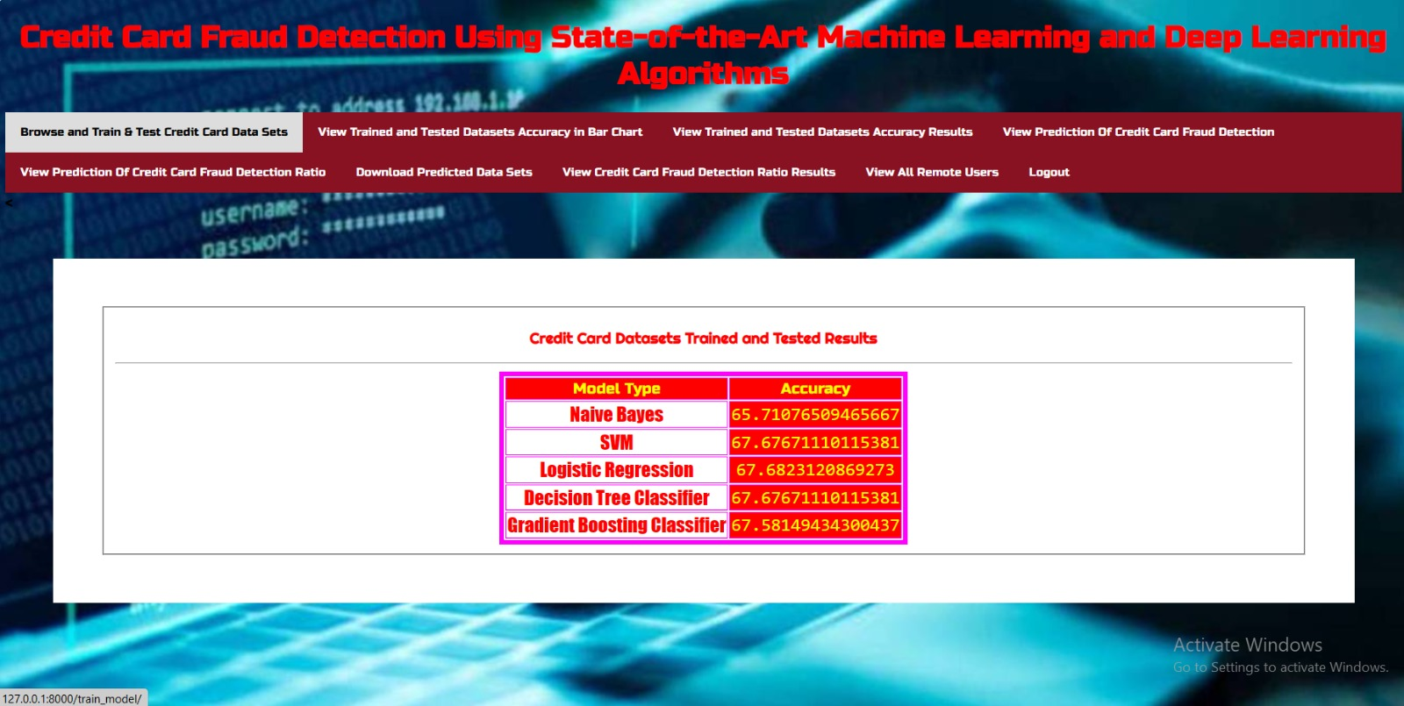

Slide 24
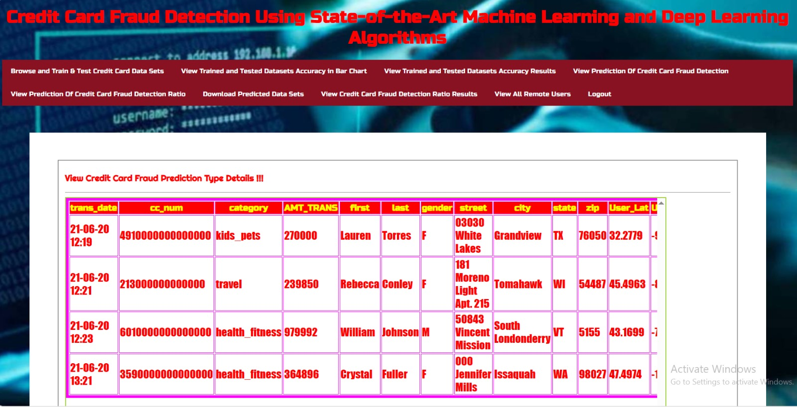

Slide 25
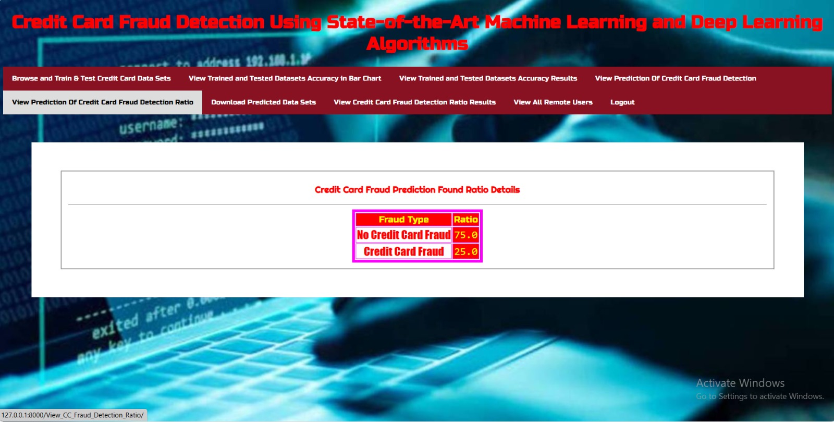

Slide 26
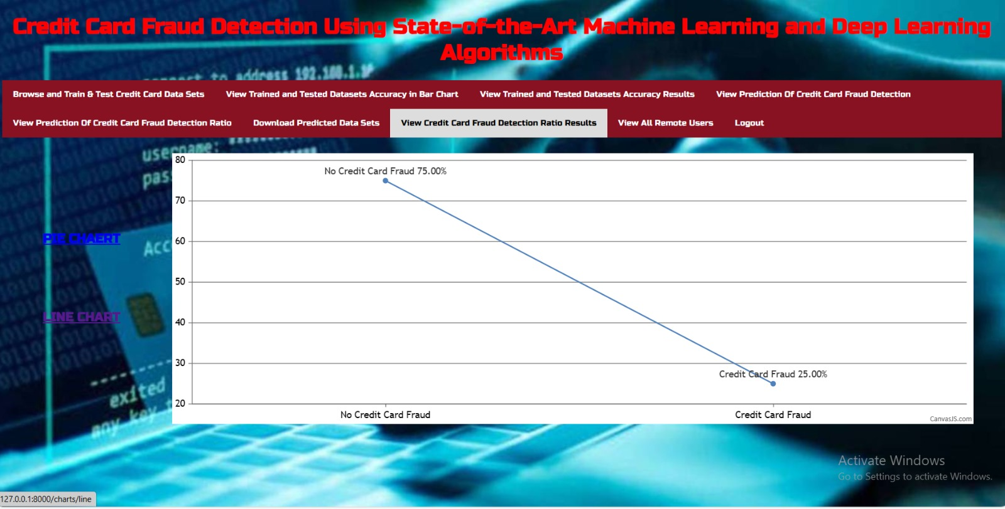

Slide 27
FUTURE SCOPE
The future scope for this project involves further advancements in fraud detection by exploring novel feature selection techniques tailored to the nuances of credit card transaction data.
Continuously refining deep learning architectures, including convolutional neural networks (CNNs), by experimenting with diverse layers and configurations, can unlock even greater predictive power. Additionally, future endeavors could delve into ensemble methods to combine the strengths of multiple models for more robust and accurate fraud detection systems. Further research may also focus on enhancing interpretability and explainability of these models, ensuring transparency and trustworthiness in decision-making processes.
Collaboration with financial institutions and regulatory bodies can facilitate the integration of these cutting-edge techniques into real-world applications, ultimately bolstering the security and efficiency of credit card transactions on a broader scale.

Slide 28
REFERENCES
1. Y. Abakarim, M. Lahby, and A. Attioui, ‘‘An efficient real time model for credit card fraud detection
based on deep learning,’’ in Proc. 12th Int. Conf. Intell. Systems: Theories Appl., Oct. 2018, pp. 1–7, doi:
10.1145/3289402.3289530.
2. H. Abdi and L. J. Williams, ‘‘Principal component analysis,’’ Wiley Interdiscipl. Rev., Comput. Statist.,
vol. 2, no. 4, pp. 433–459, Jul. 2010, doi: 10.1002/wics.101.
3. V. Arora, R. S. Leekha, K. Lee, and A. Kataria, ‘‘Facilitating user authorization from imbalanced data
logs of credit cards using artificial intelligence,’’ Mobile Inf. Syst., vol. 2020, pp. 1–13, Oct. 2020, doi:
10.1155/2020/8885269.
4. A. O. Balogun, S. Basri, S. J. Abdulkadir, and A. S. Hashim, ‘‘Performance analysis of feature selection
methods in software defect prediction: A search method approach,’’ Appl. Sci., vol. 9, no. 13, p. 2764,
Jul. 2019, doi: 10.3390/app9132764.

Slide 29
CONCLUSION
In conclusion, credit card fraud detection using machine learning and deep learning algorithms has proven to be a powerful and effective approach to safeguarding financial transactions.
These techniques have enabled the development of robust fraud detection systems that can learn and adapt to evolving fraud patterns, ultimately reducing false positives and increasing the accuracy of identifying fraudulent transactions.
The combination of feature engineering, anomaly detection, and predictive modeling has significantly enhanced the security of credit card transactions, providing both financial institutions and customers with greater peace of mind.

Slide 30
THANK YOU

